Slide 1


Popular Content Categories
Social Buzz

Slide 2


Today's agenda
Project recap
Problem
The Analytics team
Process
Insights
Summary

Slide 3

Social Buzz is a fast growing technology unicorn that need to adapt quickly to its global scale.
Accenture is running a 3 month initial project in order to focus on these tasks
An audit of Social Buzzbig data practice
Recommendations for a successful IPO
An analysis that shows the top 5 popular categories of content
Project Recap

Slide 4


Problem
Over 10000 posts per day
36,500,000 pieces of content per year!
But how to capitalize on it when there is so much to analyse???

Slide 5



Andrew Fleming
Chief Technology Architect
The Analytics team
Marcus Rompton
Senior Principal
Punarva
Data Analyst

Slide 6
Process
1
Data Understanding
2
Data Cleaning
Data Modelling
3
4
Data Analysis
5
Insights

Slide 7

Insights
Engaging Content
More than 25000+ data collected in span of 3 months
Tables for Analysis of Categories
Content,Reactions and Reaction Types
16 Categories

Slide 8
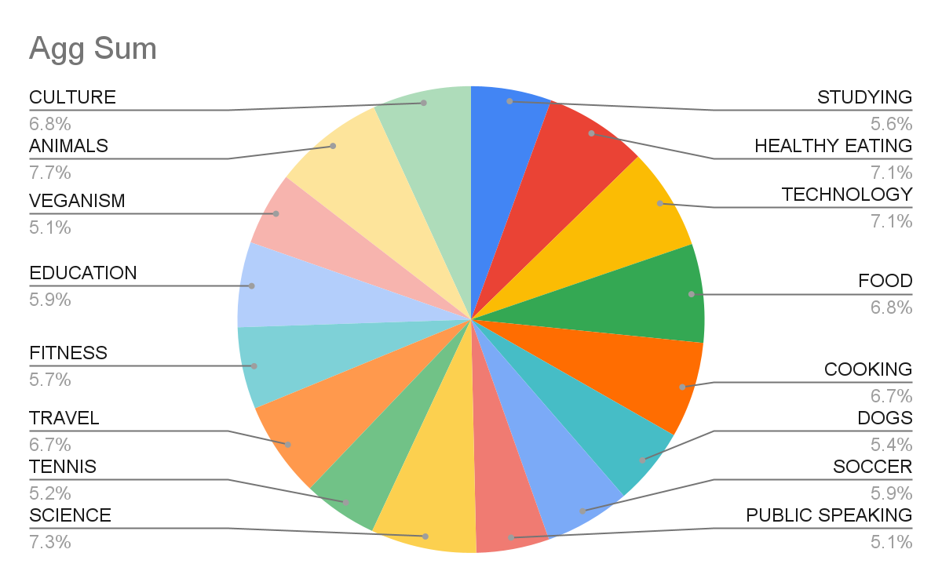
16 Categories
Animal is the Popular Category with reaction of 74965.

Slide 9
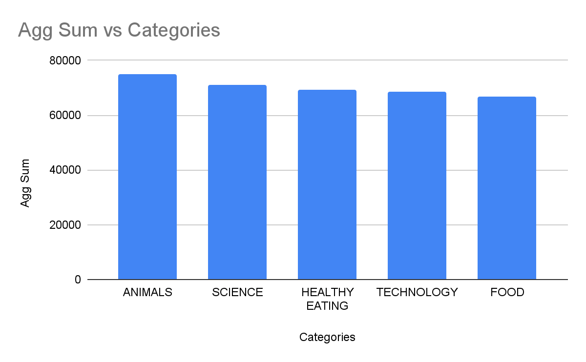
Top 5 Popular Content Categories

Slide 10

Increase Marketing for Content Creation in these 5 Categories can generate more Profit for social Buzz.
Performance Metrics Tracking:
Social Buzz can track key performance metrics such as user growth, engagement rates, retention rates, and content reach over time.
By tracking user reactions on every piece of content and emphasizing trending content in user feeds, Social Buzz can analyze patterns in user engagement
Summary

Slide 11

Thank you!
ANY QUESTIONS?

